Slide 1
Resting Alpha state activity related to SNR 50
Methods
Participants (n=15): Age>50 with mild to moderate hearing loss
Measures:
Alpha power (7.5-12.5 hz) in occipital brain regions
Signal to noise ratio (SNR) threshold at 50% correct (SNR-50)
Subjective measures of hearing loss
EEG
64-channel EEG monitored using Neuroscan
Reference – Cz. Ground – Afz
Eyes alternate between open and closed conditions lasting 2 minutes each. 3 trials. 12 minutes total
EEG data analyzed in Matlab using Fieldtrip
Data bandpass filtered between .5 and 50 hz
Independent component analysis removed components related to signal, eye movement, and cardiac noise
FFT analysis run using Hanning window
Area under the curve calculated for power between 7.5-12.5 hz

Slide 2
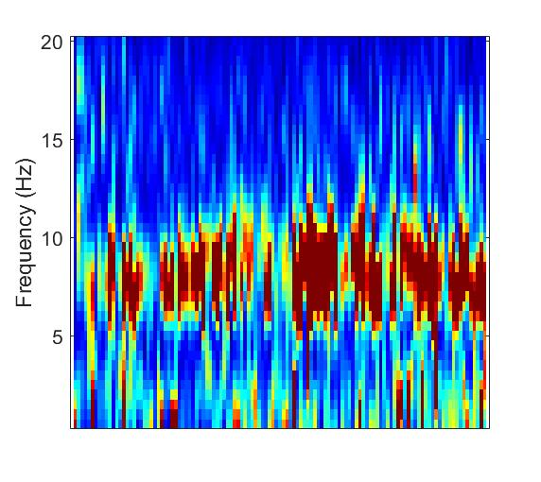
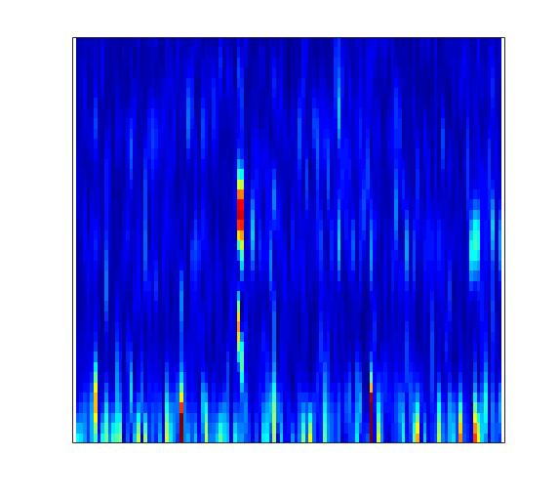
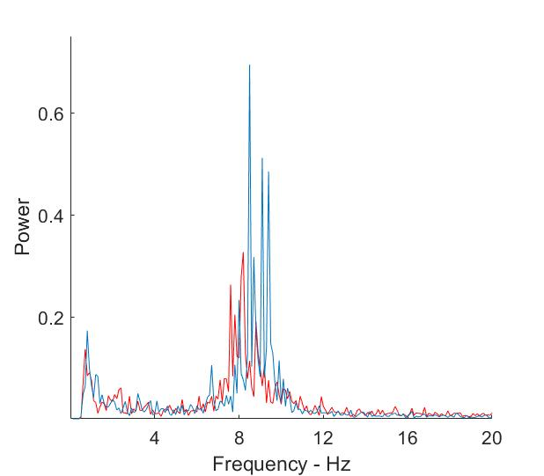
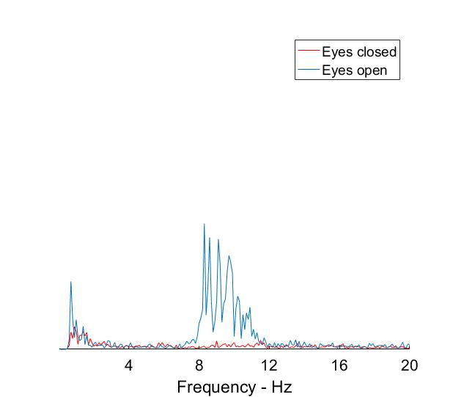

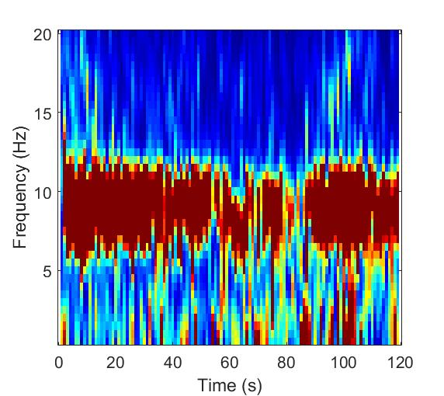
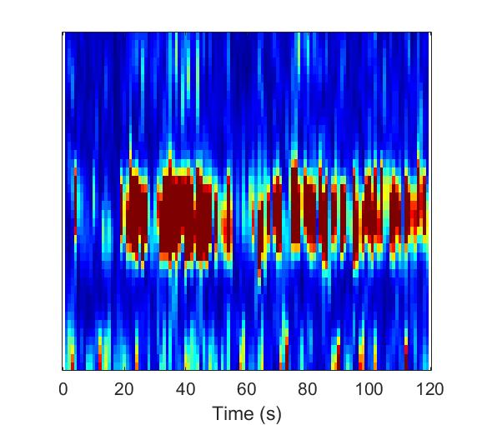
Sample Spectral data from single subject
Power
Frequency (Hz)
Frequency (Hz)
Time (seconds)

Slide 3
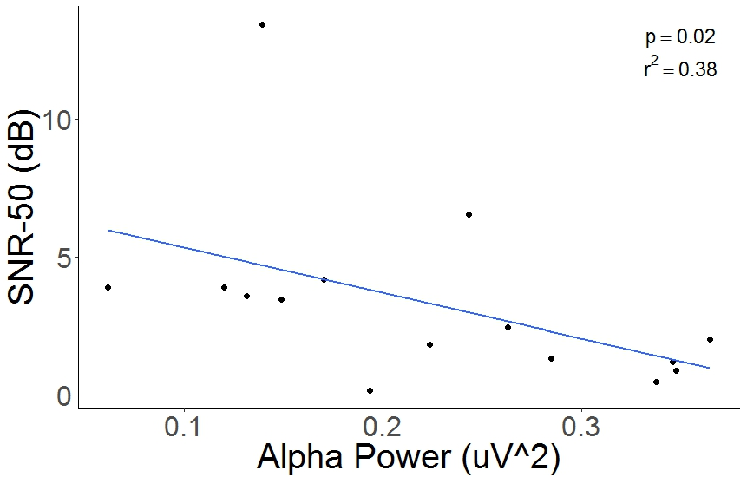
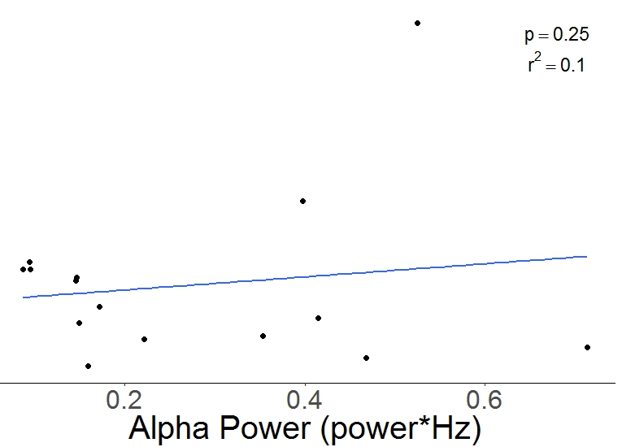
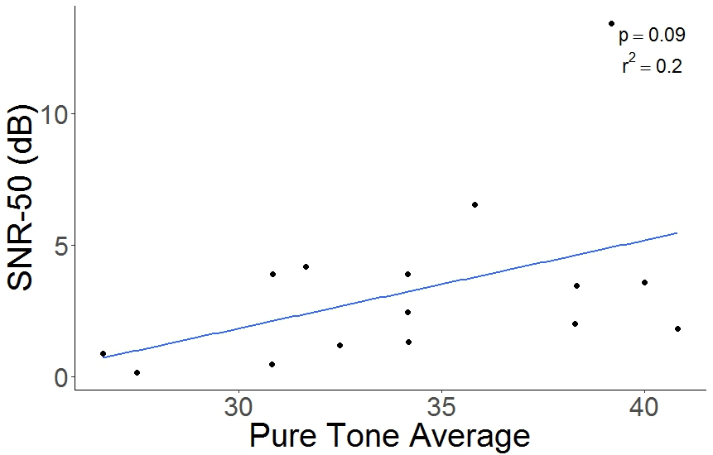
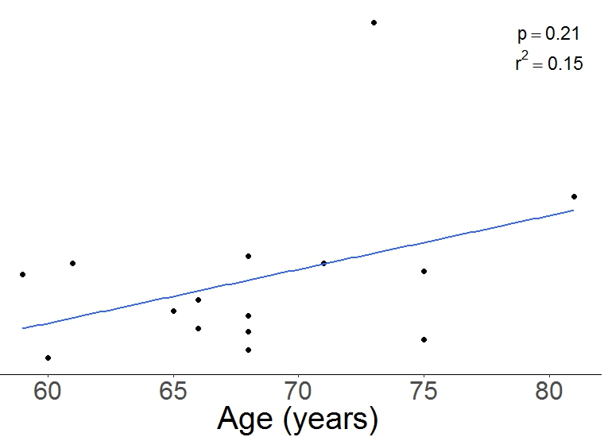
Results
Notes:
p=0.098044, 0.08878

